Slide 1
Wisconsin Judicial College: Indian Law – A Very Brief Primer
Hon. Eugene Whitefish, Forest County Potawatomi Tribal Court
Attorney Paul Stenzel, Stenzel Law Office, LLC
Sturgeon Bay, WI - August 29, 2017

Slide 2
Overview
Background on WI Tribes
Indian Child Welfare Act
Public Law 280

Slide 3
Overview
Background on WI Tribes
Indian Child Welfare Act
Public Law 280

Slide 4
11 Federally recognized Tribes in WI:
6 Chippewa bands – Bad River, Lac Courte Oreilles, Lac du Flambeau, Red Cliff, Sokaogon, St. Croix.
Stockbridge-Munsee (Mohican)
Menominee
Oneida
Ho-Chunk
Potawatomi

Slide 5
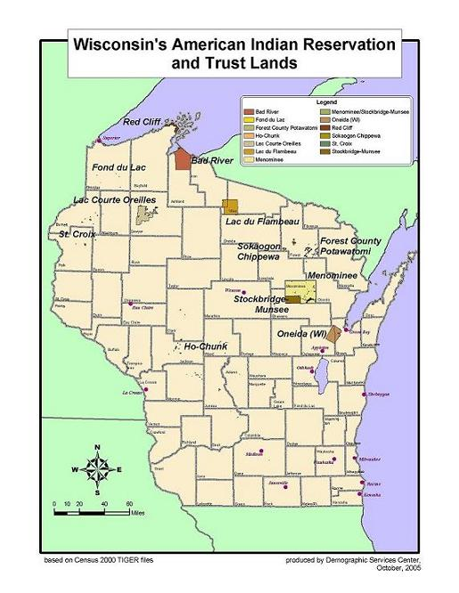

Slide 6
All tribes have a Tribal Court with varying areas of jurisdiction being exercised.
Different from state courts in that each tribe has its own substantive law.
Similar to state courts in that tribes, like counties, have a lot of overlap but different local rules and practices.

Slide 7
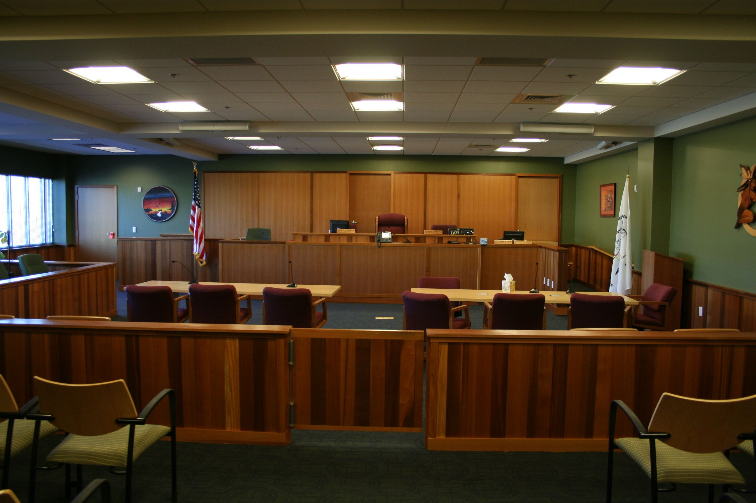

Slide 8
The United States recognizes Indian tribes as “domestic dependent nations.”
Cherokee Nation v. Georgia, 30 U.S. (5 Pet.) 1, 17 (1831).

Slide 9
Tribes do not draw their powers from any source of federal law. Rather, they are the inherent powers of sovereigns that pre-exist the federal Union.
United States v. Wheeler, 435 U.S. 313, 323-24 (1978); Talton v. Mayes, 163 U.S. 376, 384 (1896).

Slide 10
As such, Indian Tribes are not subject to the constitutional restraints that bind the federal government and the states. See Talton v. Mayes, 163. U.S. 376, 382-84 (1896).
However, Congress has plenary authority over Indian affairs and may impose such restraints by statute. See Washington v. Confederated Bands & Tribes of Yakima Indian Nation, 439 U.S. 466, 47-71 (1979).

Slide 11
About once per year federal government publishes list of federally recognized Indian tribes.
81 FR 5109 (Jan. 29, 2016)

Slide 12
Background on WI Tribes
Indian Child Welfare Act
Public Law 280

Slide 13
The Indian Child Welfare Act (ICWA), 25 USC §§1901 et seq. governs state action to remove an Indian child from the home.
Wisconsin adopted its own version in Wis. Stat. § 48.028 (Enacted in 2009).
When an Indian child is removed from his or her home or parental rights to that child are terminated, special rules apply to many aspects of the case.

Slide 14
The most common application is in CHIPs and TPR proceedings. In those cases, Indian tribes must be noticed if the child at issue is a member or eligible for membership in an Indian tribe.
Once the ICWA applies, special rules apply:
Case can be transferred from state court to tribal court
Preferences on placement
Higher burden of proof
Active efforts by social services to rehabilitate family
Expert testimony needed

Slide 15
Background on WI Tribes
Indian Child Welfare Act
Public Law 280

Slide 16
In 1953 Congress enacted what is known as Public Law 280. That statute designated that certain states would have jurisdiction over Indian tribes.
Up until then, state jurisdiction on reservations very limited.

Slide 17
Under Public Law 280, Wisconsin granted concurrent criminal jurisdiction on Indian reservations. (Except Menominee).
Regarding civil jurisdiction, Wisconsin has civil adjudicatory jurisdiction. (As opposed to civil regulatory.) See Bryan v. Itasca County, 426 U.S. 373 (1976).

Slide 18
Under Public Law 280, states have concurrent jurisdiction with tribes over civil adjudicatory issues.
From time to time state and tribal court jurisdiction overlap with each other. Parties may forum shop.
Issue came to a head in Teague v. Bad River Band, 2003 WI 118.

Slide 19
Teague was an employment case, but the rule applies to any type of subject matter area.
When a state and tribal court have concurrent jurisdiction, the judges shall hold a hearing on the record and then confer to decide how to allocate jurisdiction based on factors enumerated in case. 2003 WI 118 at ¶ 71. (Factors are based on comity.)

Slide 20
After Teague, new era of state and tribal court collaboration.
Effective 1-1-09, the Wisconsin Supreme Court enacted Wis. Stat. sec. 801.54 which permits state courts to transfer a case to a tribal court in the appropriate situation. 2008 WI 114

Slide 21
This was a cursory review of some complex issues:
Recommended follow up reading:
American Indian Law in a Nutshell, 6th ed. (West)
Cohen’s Handbook of Federal Indian Law, 2005 Edition (LexisNexis)
KNOW WHAT YOU DON’T KNOW

Slide 22
You can find a lot more outlines and materials about Indian law on various topics at: www.paulstenzel.com
Contact me at:
paul.stenzel@wicourts.gov

